Slide 1
Password Security (Password Attack)
Brute Force
Dictionary Attack
Rainbow Tables

Slide 2
Cracking Password ?
From hashed password work out the password
Trying to break one-way function
SHA1(password) = PasswdHash → stored in DB
When a hacker obtains password hashes, he can use some methods trying to figure out the passwords
For example:
da39a3ee5e6b4b0d3255bfef95601890afd80709
is the result of SHA1("") . How to crack this?

Slide 3
Brute Force Attack need a string generator
Brute Force Attack –
take all possible characters in alphabet and try all possible combinations (up to certain length)
Example 1: alphabet = {a,b,c}, length up to 3, we try { a, b, c,
aa, ab, ac, ba, bb, bc, ca, cb, cc,
aaa, aab, aac, aba, abb, abc, …… ccc }
Example 2: Alphabet = {0, 1, 2, …, 9}, need to try
{0,1,2,3,4,5,6,7,8,9, 00,01,…,09, 10, 11, 12, … 999}

Slide 4
Brute Force – how expensive
Brute force is very slow.
When alphabet size is 36 (letters + digits),
total search space for length of 6 is
36⁶ = 2,176,782,336
for length = 8
36⁸ = 101,559,956,668,416
How to avoid brute force attack? (never use short passwords)

Slide 5
Dictionary Attack
In order to speed up
we can create a table which collects commonly used word and phrases
The table stores a collection of pre-computed password hashes:
(password_hash1, password1)
(password_hash2, password2)
(password_hash3, password3)
……
this should be implemented as a hash table!

Slide 6
A ‘salted’ password
Password salting – a method to avoid dictionary attack and rainbow table attack.
Add a string (called a salt) to password.
The string is not encrypted.
One string shared by every user or one string per user ? (can be both, but one per user is better)
Can salted passwords make brute force harder? (no! the search space is not changed)

Slide 7
Rainbow Table (why)
Dictionary attack is effective for passwords in the dictionary
Why don’t we make our dictionary large enough to cover almost everything?
No! not enough space
Solution - add some run time search
time-memory trade-off
i.e. use computation time to ‘buy’ some space

Slide 8
Rainbow Table (what)
Instead of store individual password hash, we create a chain of password hashes
rong -> 2a7b => www -> 450f => xyz -> 9aae => yang
-> crypto hash => your own hash function
e.g. sha1 (it is called reduced function)
Pre-compute the chain, but only store the begin and the end of the chain (typical length=5000 ?)
Use many many chains to cover all passwords in a given alphabet .

Slide 9
Rainbow Table (how to build)
rong -> 2a7b => www -> 450f => xyz -> 9aae => yang
today -> ccab => usa -> 09c2 => dog -> 10da => sad
great -> 3087 => ddc -> 450f => xyz -> 0ace => hahaha
unix -> acfb => fun -> abcf => tttt -> ff54 => super
uwe -> 2c90 => love -> 4890 => abcd -> 8900 => bristol
For the above hash chains, we store their first and last password in the chain as a pair.
(rong, yang)
(today, sad)
(great, hahaha)
(unix, super)
(uwe, bristol)
-> crypto hash function
=> Reduce function

Slide 10
Rainbow Table (how to use it)
rong -> 2a7b => www -> 450f => xyz -> 9aae => yang
today -> ccab => usa -> 09c2 => dog -> 10da => sad
great -> 3087 => ddc -> 450f => xyz -> 0ace => hahaha
unix -> acfb => fun -> abcf => tttt -> ff54 => super
uwe -> 2c90 => love -> 4890 => abcd -> 8900 => bristol
In computer, For example, when crack abcf
we store pairs
(first, last):
(rong, yang)
(today, sad)
(great, hahaha)
(unix, super)
(uwe, bristol)
we do the following steps:
apply reduce function to a hashed password, in the 1st run
we get reduced(adcf) = tttt
(2) check if tttt is in the list of last chains, if yes go to step (4)
(3) apply sha1(tttt) = ff54, then go back to step (1)
(4) go to the beginning of the chain, follow the chain to get the password

Slide 11
How to write reduce function
Step 1 - mapping hashed password into an integer n between 0 – SizeOfPasswordSpace. pick a prime p, p > SizeOfPasswordSpace
e.g. n = (sum of all ASCII code) % p
Step 2 = mapping n to a password
i.e. to have a function to map every password to an unique integer.
intToPasswd(n)

Slide 12
Reduce Function Reduce(hashes) => password
String Reduce(hashes) {
int i = MyH(hashes);
// ‘MyH’ is your own hash function which
// maps a password hash to an integer
String s = intToPasswd(i);
return s;
}

Slide 13
Go through a very small example
Assume that our password space is = {a,b,c,…z, aa, ab, ac} , a total 29 strings
Why 29 ? 29 is a prime number.
Note that, if you use {a,b,c} as alphabet, and pick up 29, you will have = {a,b,c, aa, ab, ac, ba, bb, bc, ca, cb, cc, aaa, aab, aac, aba, abb, abc, aca, acb, acc, baa, bab, bac, bba, bbb, bbc, bca, bcb}
Let’s use normal 26 letters alphabet for today

Slide 14
86f7e437faa5a7fce15d1ddcb9eaeaea377667b8 = sha1(a)
e9d71f5ee7c92d6dc9e92ffdad17b8bd49418f98 = sha1(b)
84a516841ba77a5b4648de2cd0dfcb30ea46dbb4 = sha1(c)
3c363836cf4e16666669a25da280a1865c2d2874 = sha1(d)
58e6b3a414a1e090dfc6029add0f3555ccba127f = sha1(e)
4a0a19218e082a343a1b17e5333409af9d98f0f5 = sha1(f)
54fd1711209fb1c0781092374132c66e79e2241b = sha1(g)
27d5482eebd075de44389774fce28c69f45c8a75 = sha1(h)
042dc4512fa3d391c5170cf3aa61e6a638f84342 = sha1(i)
5c2dd944dde9e08881bef0894fe7b22a5c9c4b06 = sha1(j)
13fbd79c3d390e5d6585a21e11ff5ec1970cff0c = sha1(k)
07c342be6e560e7f43842e2e21b774e61d85f047 = sha1(l)
6b0d31c0d563223024da45691584643ac78c96e8 = sha1(m)
d1854cae891ec7b29161ccaf79a24b00c274bdaa = sha1(n)
7a81af3e591ac713f81ea1efe93dcf36157d8376 = sha1(o)
516b9783fca517eecbd1d064da2d165310b19759 = sha1(p)
22ea1c649c82946aa6e479e1ffd321e4a318b1b0 = sha1(q)
4dc7c9ec434ed06502767136789763ec11d2c4b7 = sha1(r)
a0f1490a20d0211c997b44bc357e1972deab8ae3 = sha1(s)
8efd86fb78a56a5145ed7739dcb00c78581c5375 = sha1(t)
51e69892ab49df85c6230ccc57f8e1d1606caccc = sha1(u)
7a38d8cbd20d9932ba948efaa364bb62651d5ad4 = sha1(v)
aff024fe4ab0fece4091de044c58c9ae4233383a = sha1(w)
11f6ad8ec52a2984abaafd7c3b516503785c2072 = sha1(x)
95cb0bfd2977c761298d9624e4b4d4c72a39974a = sha1(y)
395df8f7c51f007019cb30201c49e884b46b92fa = sha1(z)
e0c9035898dd52fc65c41454cec9c4d2611bfb37 = sha1(aa)
da23614e02469a0d7c7bd1bdab5c9c474b1904dc = sha1(ab)
0c11d463c749db5838e2c0e489bf869d531e5403 = sha1(ac)
Results from hashing all
passwords. Using sha1

Slide 15
Reduce( 86f7e437faa5a7fce15d1ddcb9eaeaea377667b8 ) = 11 → l
Reduce( e9d71f5ee7c92d6dc9e92ffdad17b8bd49418f98 ) = 6 → g
Reduce( 84a516841ba77a5b4648de2cd0dfcb30ea46dbb4 ) = 11 → l
Reduce( 3c363836cf4e16666669a25da280a1865c2d2874 ) = 4 → e
Reduce( 58e6b3a414a1e090dfc6029add0f3555ccba127f ) = 0 → a
Reduce( 4a0a19218e082a343a1b17e5333409af9d98f0f5 ) = 16 → q
Reduce( 54fd1711209fb1c0781092374132c66e79e2241b ) = 26 → aa
Reduce( 27d5482eebd075de44389774fce28c69f45c8a75 ) = 13 → n
Reduce( 042dc4512fa3d391c5170cf3aa61e6a638f84342 ) = 18 → s
Reduce( 5c2dd944dde9e08881bef0894fe7b22a5c9c4b06 ) = 25 → z
Reduce( 13fbd79c3d390e5d6585a21e11ff5ec1970cff0c ) = 28 → ac
Reduce( 07c342be6e560e7f43842e2e21b774e61d85f047 ) = 21 → v
Reduce( 6b0d31c0d563223024da45691584643ac78c96e8 ) = 25 → z
Reduce( d1854cae891ec7b29161ccaf79a24b00c274bdaa ) = 22 → w
Reduce( 7a81af3e591ac713f81ea1efe93dcf36157d8376 ) = 26 → aa
Reduce( 516b9783fca517eecbd1d064da2d165310b19759 ) = 0 → a
Reduce( 22ea1c649c82946aa6e479e1ffd321e4a318b1b0 ) = 24 → y
Reduce( 4dc7c9ec434ed06502767136789763ec11d2c4b7 ) = 5 → f
Reduce( a0f1490a20d0211c997b44bc357e1972deab8ae3 ) = 28 → ac
Reduce( 8efd86fb78a56a5145ed7739dcb00c78581c5375 ) = 20 → u
Reduce( 51e69892ab49df85c6230ccc57f8e1d1606caccc ) = 8 → i
Reduce( 7a38d8cbd20d9932ba948efaa364bb62651d5ad4 ) = 26 → aa
Reduce( aff024fe4ab0fece4091de044c58c9ae4233383a ) = 10 → k
Reduce( 11f6ad8ec52a2984abaafd7c3b516503785c2072 ) = 13 → n
Reduce( 95cb0bfd2977c761298d9624e4b4d4c72a39974a ) = 9 → j
Reduce( 395df8f7c51f007019cb30201c49e884b46b92fa ) = 16 → q
Reduce( e0c9035898dd52fc65c41454cec9c4d2611bfb37 ) = 28 → ac
Reduce( da23614e02469a0d7c7bd1bdab5c9c474b1904dc ) = 8 → i
Reduce( 0c11d463c749db5838e2c0e489bf869d531e5403 ) = 13 → n
Results from applying
a reduce function.
For all Hex numbers H_{i}
Work out H_{i} * C_{i}
then add them
all together, mod 29
Where i = 0,1,2, … 39
In this example we use
C = 3
Note that,
changing C will give us a different reduce
function

Slide 16
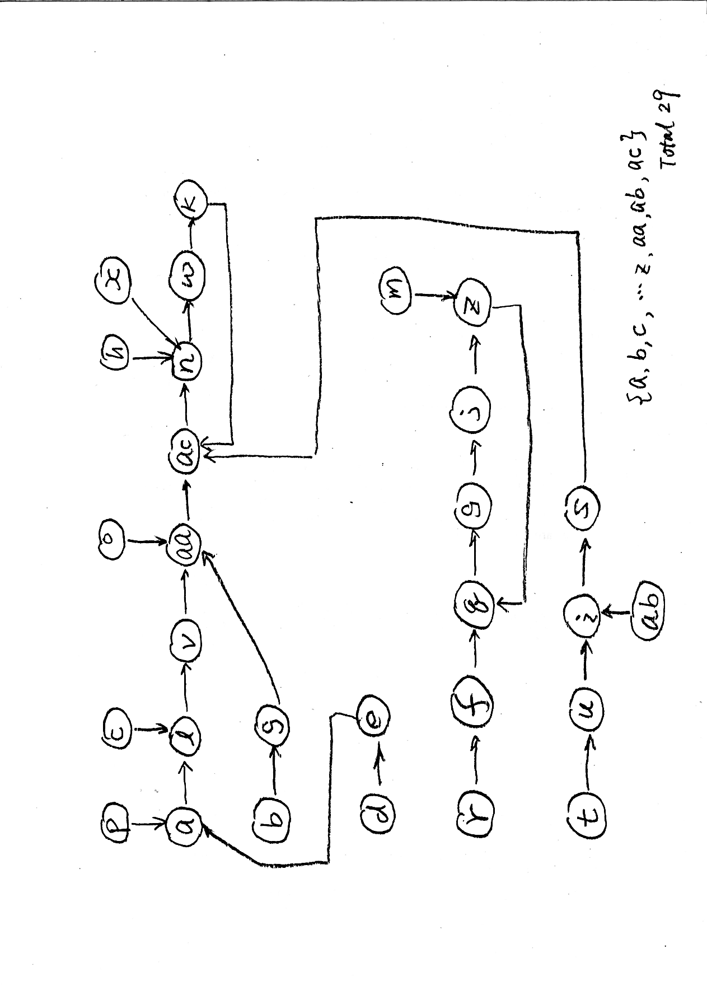
Reduce(sha1(a)) = 11 → l
Reduce(sha1(b)) = 6 → g
Reduce(sha1(c)) = 11 → l
Reduce(sha1(d)) = 4 → e
Reduce(sha1(e)) = 0 → a
Reduce(sha1(f)) = 16 → q
Reduce(sha1(g)) = 26 → aa
Reduce(sha1(h)) = 13 → n
Reduce(sha1(i)) = 18 → s
Reduce(sha1(j)) = 25 → z
Reduce(sha1(k)) = 28 → ac
Reduce(sha1(l)) = 21 → v
Reduce(sha1(m)) = 25 → z
Reduce(sha1(n)) = 22 → w
Reduce(sha1(o)) = 26 → aa
Reduce(sha1(p)) = 0 → a
Reduce(sha1(q)) = 24 → y
Reduce(sha1(r)) = 5 → f
Reduce(sha1(s)) = 28 → ac
Reduce(sha1(t)) = 20 → u
Reduce(sha1(u)) = 8 → i
Reduce(sha1(v)) = 26 → aa
Reduce(sha1(w)) = 10 → k
Reduce(sha1(x)) = 13 → n
Reduce(sha1(y)) = 9 → j
Reduce(sha1(z)) = 16 → q
Reduce(sha1(aa)) = 28 → ac
Reduce(sha1(ab)) = 8 → i
Reduce(sha1(ac)) = 13 → n

Slide 17
The picture in previous slide shows how all password are connected by using a single reduce function and sha1
Assume we set the length of chain as 5 passwords. It is possible to create the following chains.
d → e → a →l → v
o → aa → ac → u → w
r → f → q → y → j
t → u → i → s → ac
m → z→ q → y→ j
b → g → aa → ac → n
we will store (d,v), (o,w), (r,j), (t,ac), (m,j), and(b,n)
Check the coverage:
p, c, k, h, x, ab
are not covered
Check overlaps:
example of ‘false alarm’. If password is g, we start the chain from aa, then get ac. We will pick the chain (t,ac) which is wrong!

Slide 18
Rainbow Table (issues)
What is a good reduce function?
Create max coverage of all passwords,
Avoid chain collision
What is Chain Collision? - different hashes reduced to a same password:
rong -> 2a7b => www -> 450f => xyz -> 9aae => yang
today -> ccab => www -> 450f => xyz -> 9aae => yang
Solutions?
Remember all, more search time, go through all chains,
Or, lose some passwords

Slide 19
Rainbow Table = Hash Chains with Different reduce functions at each step
To solve chains collision
rong -> 2a7b => www -> 450f => xyz -> 9aae => yang
today -> ccab => usa -> 09c2 => dog -> 10da => sad
great -> 3087 => ddc -> 450f => xyz -> 0ace => hahaha
unix -> acfb => fun -> abcf => tttt -> ff54 => super
uwe -> 2c90 => love -> 4890 => abcd -> 8900 => bristol
H R1 H R2 H R3
H is hash function, R1, R2, and R3 are different reduce functions
Different reduce functions like difference colours, so it is named as rainbow table

Slide 20
Rainbow Table – algorithm for breaking passwords
Assume variable hash represent hashed password, pwd represents password
Need remember current chain position: pos
apply reduce function
pwd = chainReduce(hash, pos);
(2) check if pwd is in the list of last chains, if yes go to step (4)
(3) pos--; go back to step (1)
(4) go to the beginning of the chain, follow the chain to get the password

Slide 21
Rainbow Table – chain check (cont. )
Without Rainbow, the chainReduce could be just a single call to reduce function. But now we have different reduce functions at the different positions of the chain, so we have to do this:
chianReduce(hash, pos) {
pwd = reduce(hash, pos);
while (pos==the last position of the chain) {
pos++;
pwd = reduce(hash, pos); // R at pos
}
return pwd;
}

Slide 22
This Week’s Practical work
Using brute force to break a password
This week’s task is to use brute force to break a given hashed password. The program should be able to break any password which contains a maximum of six lower-case letters. The input to the program is the hashed password generated by SHA-1 function. The output must be the original password.

Slide 23
Practical (cont.)
For the testing, you can use your last week’s program to generate SHA-1 hashed passwords, then brute force it to find the original password.
There is a set of passwords (under blackboard week 5) for you to test.

